Slide 1
3. Robot Control
3.1 Fundamentals
3.2 Single-joint Control
3.3 Computed Torque Control
3.4 Lyapunov Stability Analysis
3.5 Adaptive Control
- 0 -

Slide 2
3.3 Multi-Joint Control
Independent joint control was considered under the assumptions
a) each joint is considered independent,
b) the inertia "seen" by each joint actuator is constant.
These approximations result in linear controls which subsequently result in non-uniform damping through the workspace and other undesired effects because couplings are not compensated for.
- 1 -

Slide 3
3.3 Multi-Joint Control
Three advanced multi-joint control techniques:
Computed Torque Method
Lyapunov's Method
Adaptive Control
which will be introduced here to eliminate these assumptions.
- 2 -

Slide 4
3.3.1 Computed Torque Method
Inverse Dynamics Method；
Partitioned Control Scheme；
General ideas:
Compute a nonlinear model-based control law to cancel the nonlinearities of the system and render it to a simple double integrator system. [Linearizing and decoupling control law]
Design simple linear controllers for the simple linear system.
- 3 -

Slide 5
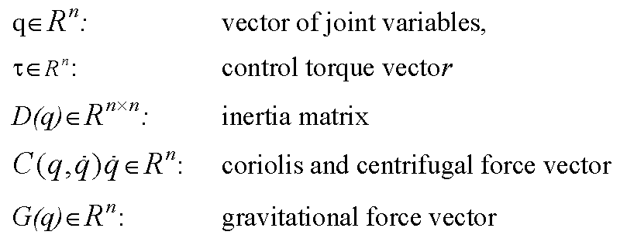
3.3.1 Computed Torque Method
For an n-DOF robot, the dynamics are described as
Define
(3.3.1)
(3.3.2)
- 4 -

Slide 6
3.3.1 Computed Torque Method
The most intuitive controller design scheme is the computed torque method.
Letting
and choose & such that
Comparing (3.3.2) and (3.3.3), we have
Controller design for system (3.3.4) becomes very simple. For trajectory tracking, we can choose
(3.3.3)
(3.3.4)
(3.3.5)
- 5 -

Slide 7
3.3.1 Computed Torque Method
Combining equations (3.3.4)-(3.3.5), we have the closed-loop error equation
Letting , , then the error equation is
decoupled so that equation (3.3.6) can be written on a jointly basis
For each joint, different closed-loop performance can be designed.
(3.3.6)
must hold for critically damped performance.
- 6 -

Slide 8
3.3.1 Computed Torque Method
Figure 3.3 Implementation block diagram
- 7 -

Slide 9
3.3.1 Computed Torque Method
The ideal performance represented by (3.3.6), i.e., is unattainable in practice due to many reasons.
The most important beings:
Inaccuracy in the manipulator model;
Discrete nature of a digital computer implementation as opposed to the ideal continuous time control law.
Remarks:
- 8 -

Slide 10
3.3.1 Computed Torque Method
Because of the problems with having good knowledge of dynamic models, there is a trade-off between complicated model based control schemes and simple PID control.
Individual Joint PID Control
Most industrial robots have simple independent joint PID control:
Present Industrial Robot Control System
- 9 -

Slide 11
3.3.1 Computed Torque Method
Advantages:
Simple and easy to implement
Robust because of decentralized control implementation structure.
Disadvantages:
No decoupling is being carried out, the motion of each joint affects the others.
It is impossible to select fixed gains which critically damp the response for all configurations.
Usually, "Average" gains are chosen which approximate critical damping at the center of the robot's work space.
- 10 -

Slide 12
3.3.1 Computed Torque Method
Since the gravity terms tend to cause static positioning errors, some robot manufacturers include a gravity model, G(q), in the control law.
The complete control law takes the form
This control is not decentralized in nature.
The architecture of control must allow communication between the joint control or make use of a central processor.
Addition of Gravity Compensation
- 11 -

Slide 13
Tutorial: Problem
Computed torque technique was introduced based on
Apply the idea to system described by
How about?
Friction
(a)
(b)
Nonsingular, Known!
(c)
(d)
Could we generalize to the nth order systems?

Slide 14
Tutorial: Solution
For system (a)
let , , .
Choose with , the closed-loop error equation is
- 13 -

Slide 15
Tutorial: Solution
For system (b), there are two methods.
let , , , .
Choose with , the closed-loop error equation is
Method 1
(B is nonsingular)
- 14 -

Slide 16
Tutorial: Solution
For system (b)
let , , .
Choose with , the closed-loop error equation is
Method 2
- 15 -

Slide 17
Tutorial: Solution
For system (c)
let , , .
Choose with , the closed-loop error equation is
- 16 -

Slide 18
Tutorial: Solution
For system (d)
let , , , .
Choose with , the closed-loop error equation is
- 17 -

Slide 19
Tutorial: Solution
When we generalize the computed torque method to the nth order systems, assume that the system model is shown as
Let , , , .
Choose with , the closed-loop error equation is
- 18 -

